Slide 1

Chemical Management User Guides:
Safety Data sheets (SDs)
Issue 1: March 2020

Slide 2
Safety Data Sheets – Introduction
Section 1
Identification
Section 2
Hazard
Section 3
Composition
Section 4
First Aid
Section 5
Firefighting measures
Section 6
Accidental release measures
Section 7
Handling & storage
Section 8
Exposure controls
2
Section 9
Physical & chemical properties
Section 10
Stability & reactivity
Section 11
Toxicological information
Section 12
Ecological information
Section 13
Disposal considerations
Section 14
Transport information
Section 15
Regulatory information
Section 16
Other information
SDSs – provide users of chemicals with necessary information
to help them protect human health & the environment
2
Notes:
NOTE:
The format of the safety data sheets is defined in the EU REACH Regulation.
Every SDS is divided into 16 sections, and each section is described in the following slides.
SDSs – provide users of chemicals with necessary information to help them protect human health & the environment

Slide 3
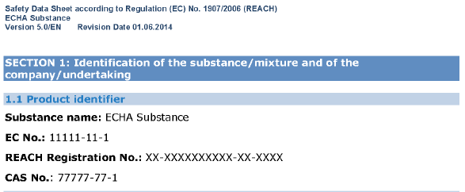
Safety Data Sheets – Sections
Section 1 Identification of the substance/mixture & of the company/undertaking
Name of a substance
Used to access information on the ECHA website
If REACH registered, registration number will be communicated down the supply chain
NO registration number:
Exempt from registration or not yet registered
Other relevant identifiers:
REACH REGISTRATION NUMBER:
01-nnnnnnnnnn-nn-nnnn
last four digits: “-0000” - lead registrant
last four digits: “-XXXX” - registrant is confidential
Alternative names,
EC# , CAS#, or Index numbers (Annex VI of CLP Regulations)
Trade name or other designation of the substance or mixture
We recommend you to keep a record of the date of receipt for all SDS that contain a registration number
Notes:
NOTE:
Section 1 Identification of the substance/mixture & of the company/undertaking
Trade name or other designation of the substance or mixture
Other relevant identifiers
Registration number
You can use registration numbers to access more information on the registrants and on the substance.
On the ECHA website in the “Information on Chemicals” section (see this website screenshot), you can search using the registration number. This shows who has registered the substance, either as individuals or as members of a joint registration. If the registration number ends with “-0000”, this is the lead registrant. If the last four digits are –XXXX, then the registrant is kept confidential; typically when a supplier supplies substances from a number of registrants. An example of this can be seen here REACH registration number (https://echa.europa.eu/documents/10162/22787005/sds_section1_registration numberXXXX_en.jpg). The search also shows if the registration number provided is still active, as well as other information.
The supplier has to communicate the registration number down the supply chain. If no registration number is given in the safety data sheet, this indicates that the substance is exempt from the registration requirements, or is not yet registered.
If you suspect that your supplier should have registered the substance already, we recommend that you contact them immediately to check. Substances which have not been registered should be checked thoroughly to confirm that they are permitted for use in Europe. You may also consider contacting the enforcement authority.
Substances may be pre-registered, that is, the manufacturer or importer intends to register them but they are not yet registered. A pre-registration number begins with “05-”. There are no downstream user obligations associated with pre-registered substances. After the 2018 registration deadline, there is no reason for the supplier to include a preregistration number in the SDS.

Slide 4
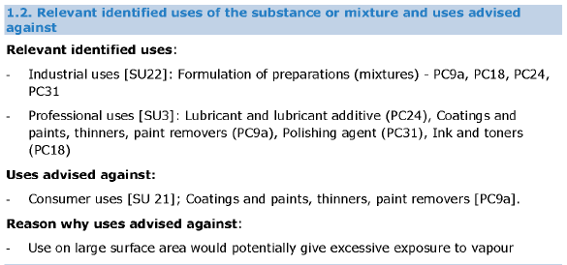
Safety Data Sheets – Sections
Section 1 Identification of the substance/mixture & of the company/undertaking
Check in Section 1.2 if your use is Identified by your supplier.
If section 1.2 specifies that your use is advised against – options
Stop this use of the substance (as such or in a mixture)
Switch to a supplier who has covered your use with appropriate RMM
Undertake a DU Chemical Safety Report to verify use is safe
Uses may be described with:
Codes from the Standard Use Descriptor System
(e.g. SU21, PC18 etc.)
Text (e.g. ‘’Coatings for Paint’’)
If the SDS has exposure scenarios, check the recommended conditions for safe use.
If your use is not covered, contact your supplier
If your supplier identifies some uses that are “advised against”
it Means that they do not support them
Notes:
NOTE:
Identified uses
When you receive a safety data sheet, you should check that your use is identified by your supplier in Section 1.2. If the SDS has exposure scenarios, check the recommended conditions for safe use.
If your use is not covered, you can contact your supplier and ask for your use to be included.
If Section 1.2 of the safety data sheet specifies that your use is advised against, you should consider the following options:
• Stop this use of the substance (as such or in a mixture);
• Switch to a supplier who has covered your use with the necessary risk management measures (RMM);
• Undertake a downstream user chemical safety report to verify that the use is safe.
The uses identified in Section 1.2 may be described with text (for example “Coatings and paints”) or codes. The codes used are often from the Standard Use Descriptor System
If your supplier identifies some uses that are “advised against”
it Means that they do not support them

Slide 5
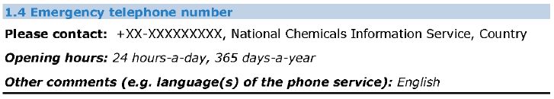
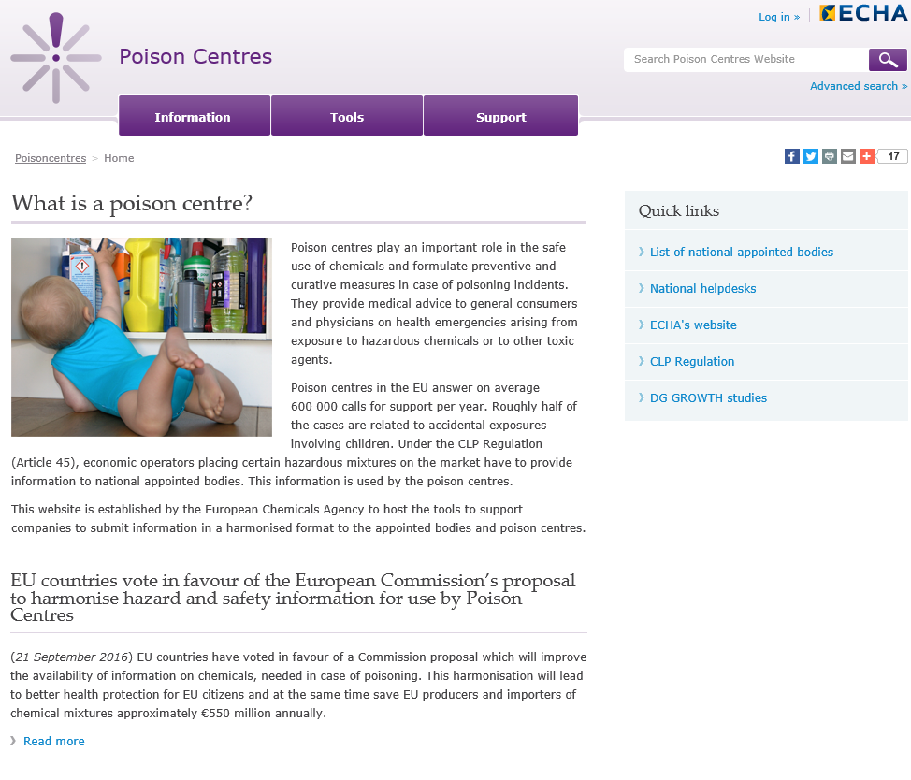
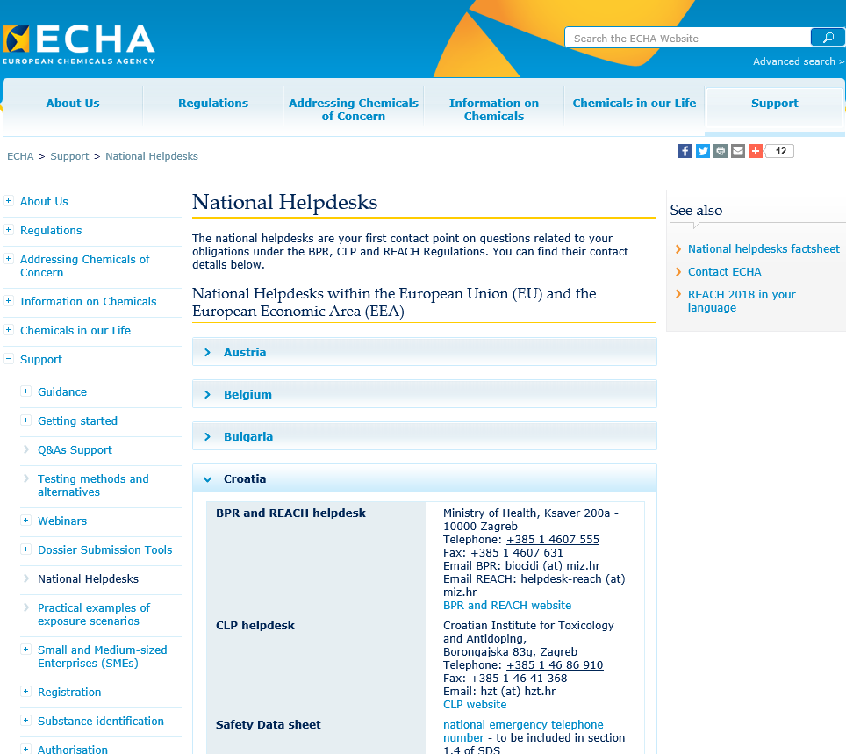
Safety Data Sheets – Sections
Section 1 Identification of the substance/mixture & of the company/undertaking
Section 1.4 – Emergency telephone number
Suppliers must provide an emergency contact number in the Country where the product is placed on the market.
Every EU Country has a National Helpdesk (poison centres) which can be contacted for further information: https://echa.europa.eu/support/helpdesks
It is the duty of the supplier to communicate their SDS to the National Poison Centers as applicable.
https://poisoncentres.echa.europa.eu/
Check that the National Emergency Number provided in SDS is correct for the Country where the chemical is used
Notes:
Section 1.4 – Emergency telephone number
You must provide a reference to emergency information services. Most Member States have national poison centres, for which the national emergency telephone numbers are available here:
http://echa.europa.eu/support/helpdesks/nationalhelpdesks/list-of-national-helpdesks
Please check with the specific poison centre, before including the number in the SDS, to ensure that you comply with the respective centre’s requirements.
Note that every Member State has to have an ‘appointed body’ that collects hazard information on mixtures. In most cases, this appointed body is the previously mentioned poison centre. More information can be found here:
http://ec.europa.eu/growth/sectors/chemicals/poison-centres/index_en.htm
Whether using national poison centres, your own or a third party’s service, any limitations (opening hours or types of information that can be provided) must be indicated.
Poisson Center: https://poisoncentres.echa.europa.eu/
ECHA National help desk: https://echa.europa.eu/support/helpdesks

Slide 6
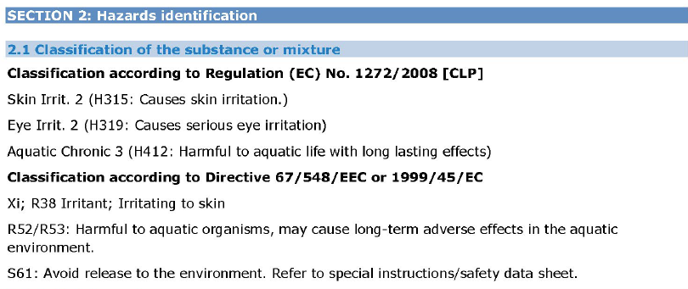
Safety Data Sheets – Sections
Section 2 Hazard identification
Gives info on:
How the chemical should be labelled (Hazard pictograms, risk phrases & safety advice)
Any additional hazard information not resulting in classification and, if relevant, why substance is PBT or vPvB
Classification of the substance or mixture:
EU CLP
(EC) No 1272/2008 )
Essential information when assessing the risk to workers and the environment
Differences in classification from different suppliers may be justified (e.g. impurities, concentrations etc.
Check classification is consistent with information in Sections 9 to 12. Additional information can be found in Section 16
If according to CLP is non-hazardous, it should be clearly stated
When classification is given in both CLP and DSD or DPD,
consider the CLP classification only.
Hazard classification of chemical
You can check the classification of substances on ECHA’s website (Infocard/Brief Profile)
to see if there is a harmonised classification.
Notes:
Section 2 gives information on:
The hazard classification of the chemical;
How the chemical should be labelled (hazard pictograms, risk phrases and safety advice).
Any additional hazard information not resulting in classification and, if relevant, why the substance is a PBT (Persistent, Bioacumulative and Toxic) or vPvB (very Persistent and very Bioacumulative)
Section 2.1 shows the hazard classification of the substance or mixture.
This information is essential when assessing the risk to the workers and the environment.
You should check whether the classification is consistent with the information provided in Sections 9 to 12.
Additional information, such as the full text of hazard statements, can be found in Section 16.
Differences in classification from different suppliers may be justified (e.g. impurities, concentrations etc.
If the criteria for classification in accordance with Regulation (EC) No 1272/2008 are not met, this should be clearly stated.
5. When classification is given in both CLP and DSD or DPD, consider the CLP classification only.
You can check the classification of substances on ECHA’s website in the Infocard/Brief Profile, in particular to see if there is a harmonised classification.

Slide 7
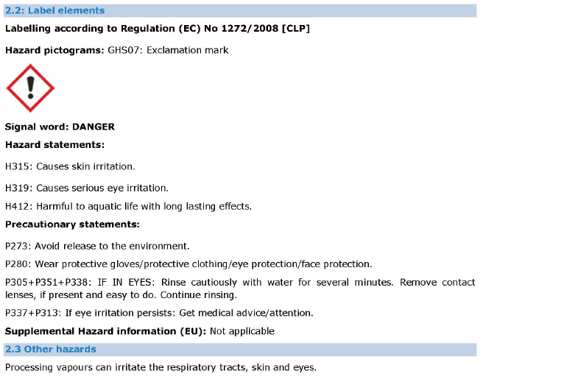
Safety Data Sheets – Sections
Section 2 Hazard identification
Must include all elements in the label of the product
Hazard pictograms
Signal Word
Precautionary elements
Supplemental hazard info
Substances and mixtures should be labelled according to CLP only
If a substance on its own or in a mixture is subject to REACH authorisation, the authorisation number must be included here.
Hazard statements
You should inform your supplier of any new Information on hazards, including classification and labelling
Notes:
Label elements
Section 2.2 shows the elements the substance or mixture should be labelled with.
Must include all elements in the label:
Hazard pictogram
Signal Word
Hazard elements
Precautionary elements
Suplemental hazard info
Substances and mixtures should be labelld according to CLP Regulation, and must include all elements appearing on the label of the product.
If a substance on its own or in a mixture is subject to REACH authorisation, the authorisation number must be included here.
You should inform your supplier without delay of any new information on hazards, including classification and labelling.

Slide 8
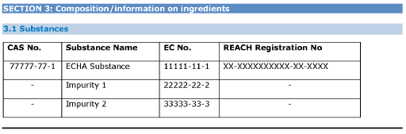
Safety Data Sheets – Sections
Section 3 Composition / information on ingredients
Provides information on the COMPOSITION:
Mixture (Section 3.2)
Tabulated information
Name, trade name,
Ingredients or impurities which:
Contribute to final hazard classification
Concentrations present is above certain levels of concern
Have Occupational exposure limits
Substance (Section 3.1)
EC # and/or CAS #,
REACH Registration # (where available),
Ingredients/impurities, etc.
For mixtures:
Concentration (or range) for classified substances
Classification of hazardous substances
Non-hazardous components (optional)
Information on Section 3.2 should be consistent with the chemical product classification (Section 2)
Notes:
Section 3 provides information on the composition of the chemical product.
If it is a substance, the information is provided in Section 3.1.
If the chemical is a mixture, the information is in Section 3.2.
The information is usually provided in a table. It includes the :
name and/or trade name, and
other identifiers (such as CAS number, registration number etc.) of the substances,
ingredients or impurities which:
Contribute to the overall hazard classification; or
Are present at concentrations above certain levels of concern; or
Have occupational exposure limits.
For mixtures, the concentration or concentration range at which the constituent is present should be provided.
A supplier can include non-hazardous constituents or components here, if choosing to list the full composition of the substance or mixture.
Information on Section 3.2 should be consistent with
the chemical product classification (Section 2)
Weight/concentration ranges
Weight ranges may be given instead of actual weight percentages. The classification derived for a particular concentration range should be based on the highest concentration in the range quoted.
Alternative chemical names
Where an alternative chemical name is being used (because it is permitted according to the provisions of Article 24 of CLP), you should indicate so in this subsection (or in Sections 15 or 16).
The generic cut-off values and M-factors are mentioned in the legal text only in the context of deciding which substances need to be listed in the SDS. However, where the information is available it would be potentially useful and therefore recommended to provide it.

Slide 9
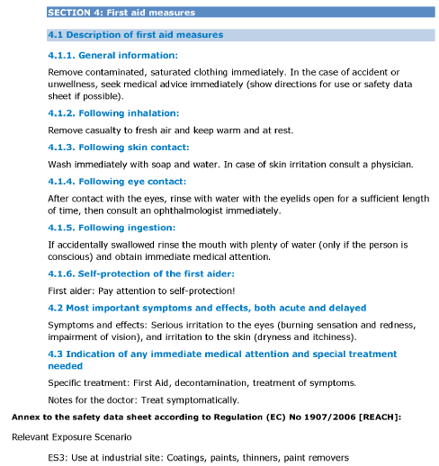
Safety Data Sheets – Sections
Gives info on
first aid measures to be applied in case of accidental exposure
The symptoms and effects of exposure;.
Indications if urgent or special medical attention (antidote/medical attention/ PPE, etc) are needed.
They must be:
described a way that untrained person can understand,
be consistent with the precautionary statements in Section 2.1.
Useful to take SDS with you when seeking medical care after accidental exposure to chemical.
Additional information for medical personnel may be given under a heading such as “Notes for the doctor”.
Section 4 First aid measures
First Aid information should be included in the Emergency Response Plan and the First Aiders trained against it
Notes:
Section 4
gives information on:
The first aid measures to be applied in case of accidental exposure to the chemical;
The symptoms and effects of exposure;
Indications on whether urgent or special medical attention (antidote, medical monitoring) or other measures (personal protective equipment for first-aiders) are needed.
The first aid measures must be:
described in such a way that they can be understood and carried out by an untrained person, and
should be consistent with the precautionary statements in Section 2.1.
It is useful to take the safety data sheet with you when seeking medical care after accidental exposure to the chemical.
Additional information provided specifically to medical personnel may be given under a heading such as “Notes for the doctor”. This information may contain special medical terms which may be difficult to understand for non-medical personnel.
First Aid information should be included in the Emergency Response Plan and the first Aiders trained against it.

Slide 10
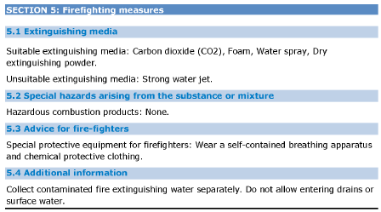
Safety Data Sheets – Sections
Section 5 Firefighting measures
Gives info on
May also contain specific information for firefighters (e.g. special PPE).
Firefighting measures
Possible hazards arising in case of fire such as
- hazardous combustion products or
- vapour cloud explosion risks.
Pay special attention to unsuitable extinguishing media described in Section 5.1
Their use may cause chemical or physical reactions resulting in an additional potential hazard.
Firefighting information should be included in the Emergency Response Plan
and the Emergency Response Team trained against it
T
Notes:
Section 5
gives information on:
The firefighting measures to be applied in case of a fire involving the chemical;
The possible hazards arising from the chemical in case of fire (such as hazardous combustion products or vapour cloud explosion risks).
This section may also contain specific information for firefighters, including special protective equipment to be used.
Pay special attention to the unsuitable extinguishing media described in Section 5.1. Their use may cause chemical or physical reactions resulting in an additional potential hazard.
For example, some substances emit flammable or toxic gases when in contact with water.
Firefighting information should be included in the Emergency Response Plan and the Emergency Response Team trained against it.

Slide 11
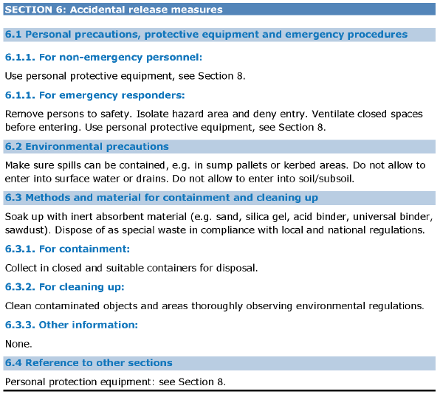
Safety Data Sheets – Sections
Section 6 Accidental release measures
How to deal with accidental spills or leaks of chemicals
Recommendations include:
Containment, recovery and cleaning methods
Personal precautions to be used during these actions
The spill Control Plan should include the control measures recommended from this Section.
Spill Control teams should be adequately trained
T
Notes:
Section 6
gives recommendations on how to deal with accidental spills or leaks of the chemical to prevent or minimize further adverse effects.
Recommendations include:
Containment, recovery and cleaning methods;
Personal precautions to be used during these actions.
The spill Control Plan should include the control measures recommended from this Section.
Spill Control teams should be adequately trained.

Slide 12
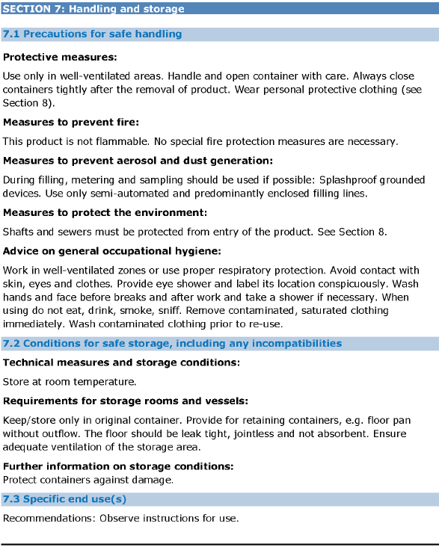
Safety Data Sheets – Sections
Section 7 Handling and storage
Safe handling advice
Containment and measures to prevent fire as well as aerosol and dust generation
Avoiding hazards due to incompatibility of substances or mixtures
Reducing release of substance or mixture to environment
Implementing good hygiene practices
Safe storage advice
Managing risks (explosive atmospheres, corrosive conditions, flammability hazards)
Control Surroundings (e.g. weather, humidity, vibration, etc).
Maintaining the integrity of substance or mixture
Other: Ventilation, quantity limits
Ensure that the Site’s handling and storage programs and procedures reflect the recommendations given in this Section.
Ensure the workers involved are appropriately trained
Notes:
Section 7 gives information on how to handle and store chemicals safely, to avoid potentially dangerous incidents.
Advice on safe handling practices includes:
Containment and measures to prevent fire as well as aerosol and dust generation;
Avoiding hazards due to incompatibility of substances or mixtures;
Reducing the release of the substance or mixture to the environment, such as avoiding spills or keeping away from drains;
Implementing good occupational hygiene practices.
Advice on safe storage practices includes:
Managing risks associated with explosive atmospheres, corrosive conditions, flammability hazards etc.;
Controlling the effects of the surroundings, such as the weather, humidity, vibration etc.;
Maintaining the integrity of the substance or mixture;
Other advice, such as ventilation requirements, quantity limits etc.
The information is appropriate for the uses identified in Section 1.2, and to the properties of the chemical (as given in particular in Sections 9 (Physical & chemical properties) and Section 10(Stability and reactivity). It should be consistent with any exposure scenario provided.
In addition to information given in this section, relevant information may also be found in Section 8 (Exposure controls).

Slide 13
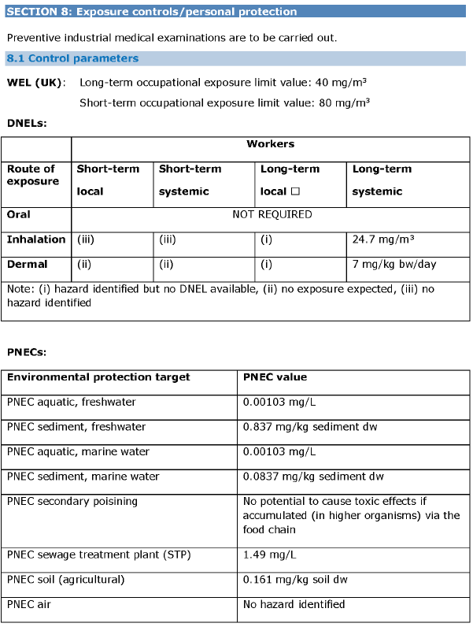
Safety Data Sheets – Sections
Section 8 Exposure controls / personal protection
Exposure limits below which the risks are considered to be controlled
For workers, consumers, environment
Occupational exposure limits (OELs)
Derived no effects levels (DNELs)
Predicted no effect concentrations (PNECs)
Limit values, below which the risks are considered to be controlled.
Recommended Monitoring methods may be included
(e.g. personal air monitoring,
room air monitoring, or
biological monitoring
The Exposure limits in this section provides
the basis for the HRA
Notes:
Section 8 contains important information related to occupational health .
Section 8.1 provides information on Expossure limits
For workers, consumers and the environment
These include:
applicable occupational exposure limits (OELs),
derived no effect levels (DNELs),
predicted no effect concentrations (PNECs) etc.
In addition to the OELs applicable in your country, limits valid in other countries may also be indicated, depending on the market of your supplier.
The control parameters contained in Section 8.1 are limit values, below which the risks are considered to be controlled
The recommended monitoring methods may be included here. These monitoring methods can be, for example,
personal air monitoring,
room air monitoring,
or biological monitoring,
according to agreed standards
The Exposure limits in this section provides the basis for the IHRAs

Slide 14
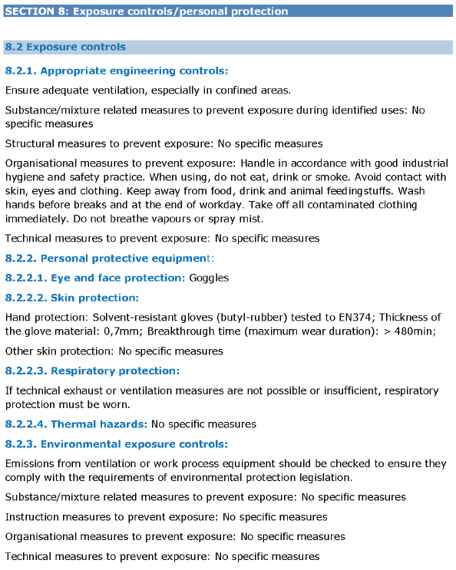
Safety Data Sheets – Sections
Section 8 Exposure controls / personal protection
Measures to manage the risks
Protective measures to reduce worker & environment exposure to a safe level
Controls
Engineered Controls
PPE controls
Environmental exposure controls
When ES are available:
detailed information on exposure controls
Must be consistent with section 8.2 summaries
Administrative controls
Section 8 is important for when applying appropriate control measures for chemical risk management
Ensure that the engineered risk control measures are on the site’s planned maintenance register
TM
Notes:
Section 8.2 Provides measures to manage the risks and to ensure the safe use of the chemical are described, covering both engineering controls and personal protection measures.
The measures are designed to reduce worker and environmental exposure to a safe level.
The controls include:
Appropriate engineering controls;
Administrative controls;
Personal protective equipment (including detailed specification such as break through time or references to appropriate CEN standards);
Environmental exposure controls.
More detailed information on exposure controls may also be found in any exposure scenarios attached to the safety data sheet.
Section 8 is important for DU when applying appropriate control measures for chemical risk management.
Ensure that the engineered risk control measures are on the Site’s planned maintenance register.
.

Slide 15
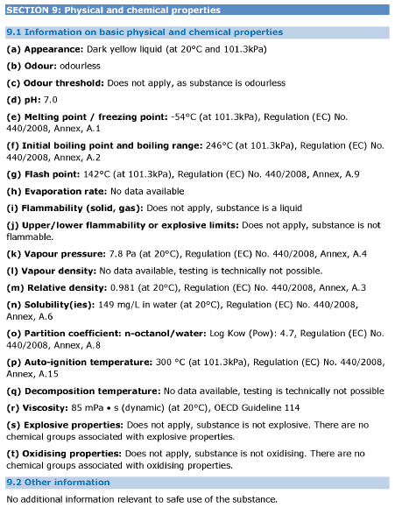
Safety Data Sheets – Sections
Section 9 Physical and chemical properties
Basic physical and chemical properties of chemical substance or mixture
Odour, pH, boiling point etc.
Physical & chemical properties
Which are relevant to hazard classification
which are NOT relevant or
where no information is available, and the reason why
This is relevant when using chemicals in chemical processes to determine safe working parameters
Physical and chemical properties can also help determine handling /storage aspects
MM
Notes:
NOTE:
Section 9 gives information on:
The basic physical and chemical properties of the chemical substance or mixture
such as appearance, odour, pH, boiling point etc.)
which are relevant to the classification and the hazards;
Physical and chemical properties
which are not relevant or
where no information is available, and the reason why.
This is relevant when using chemicals in chemical processes to determine safe working parameters.
Physical and chemical properties can also help determine handling /storage aspects

Slide 16
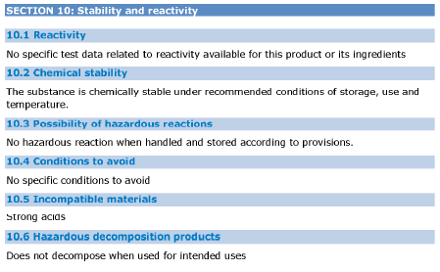
Safety Data Sheets – Sections
Section 10 Stability and reactivity
Gives information on:
Stability of the substance or mixture
Hazardous reactions under certain conditions of use or if released into the environment
Incompatible materials
Hazardous decomposition products
Hazards associated with stability & reactivity are related to physical & chemical properties in Section 9
Section 9 indicates measurable properties
Section 10 qualitative descriptions of possible consequences
This Section is important for determining the scenarios that may apply when deciding the Storage
MM
Notes:
NOTE:
Section 10
gives information on:
• The stability of the substance or mixture;
• Hazardous reactions that could occur under certain conditions of use or if released into the environment;
• Conditions to avoid;
• Incompatible materials;
• Hazardous decomposition products.
The normal practice is to use Section 9 to indicate measurable properties derived from test procedures, whereas Section 10 gives (qualitative) descriptions of possible consequences.
This Section is important for determine the scenarios that may apply when deciding the ERP scenarios to be analysed.

Slide 17
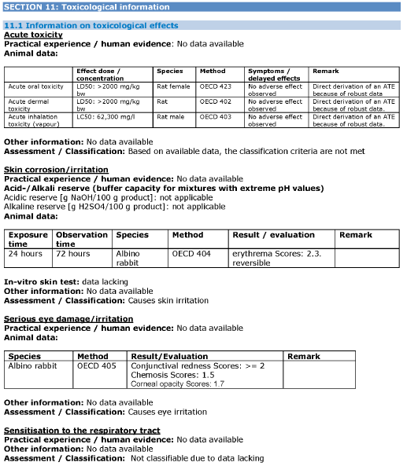
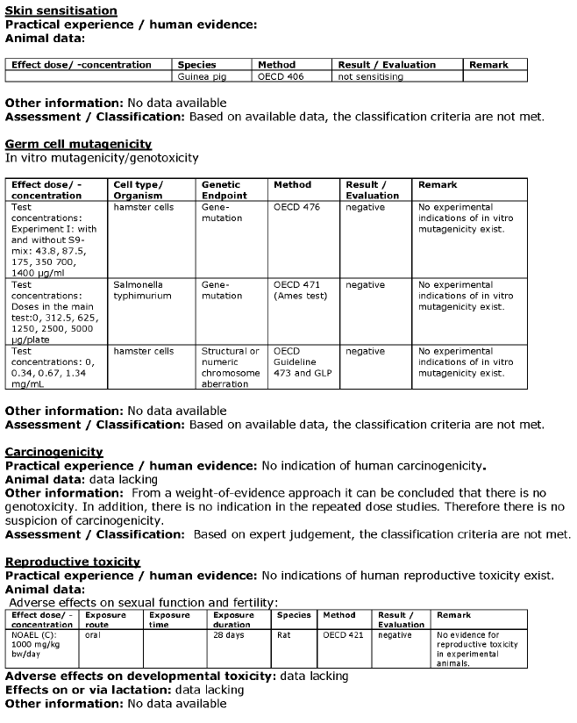
Safety Data Sheets – Sections
Section 11 Toxicological Information
Intended for:
Occupational health & safety professionals
Toxicologists
Gives info on:
Symptoms
Immediate & delayed adverse effects
Chronic effects from short & long-term exposure
Test methodologies
medical professionals
Routes of exposure
Content of this section provides basis for the classification & risk management measures given in the SDS
MM
Notes:
NOTE:
Section 11
is intended primarily for
medical professionals,
occupational health and safety professionals,
and toxicologists,
and gives detailed information on:
The likely routes of exposure;
The symptoms caused by the physical, chemical, and toxicological characteristics of the substance, mixture and/or known by-products;
The immediate and delayed adverse effects, including chronic effects, from short and long-term exposure.
Content of this section provides basis for the classification & risk management measures given in the SDS
You should also find a description of how the chemical was tested for health hazards and the test results. The content of this section provides the basis for the classification and risk management measures given in the safety data sheet. The information in Sections 2, 3, 4, 6, 7, 8, 9, 13, 14 and 15 should be consistent with the toxicological information provided here. A large quantity of information may be provided under this section, particularly in an SDS for a mixture. Ideally, it will be laid out with a clear separation between the data that apply to a mixture as a whole (where applicable) and that for individual (component) substances. Click here for an example of Section 11 for a mixture (https://echa.europa.eu/documents/10162/22786913/sds_section11_mixture_en.pdf).
A CLOSER LOOK FOR RECIPIENTS
Check that the information in this section supports the classification and is consistent with other sections of the safety data sheet as indicated in the key points.
You can also check the information in this section against the information on ECHA’s website, such as the registration information (if applicable). If you have any doubts then contact your supplier.

Slide 18
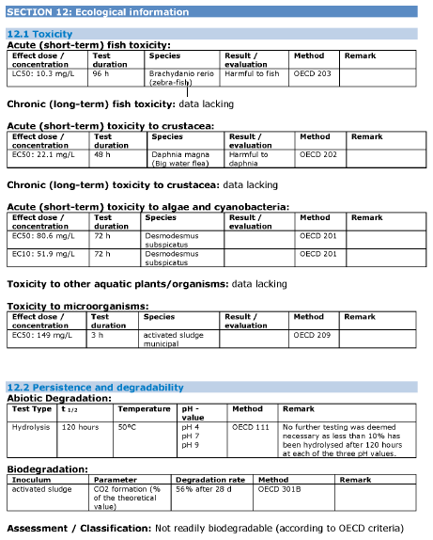
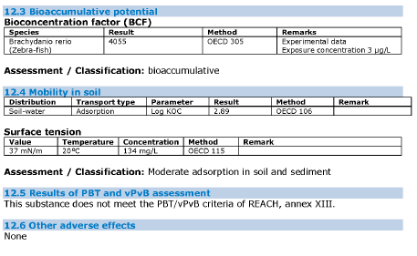
Safety Data Sheets – Sections
Section 12 Ecological information
Gives info on
PBT & vPvB assessment results
Provides basis for classification & RMM given in SDS.
Environmental Impact due to release
How chemical was tested
This information may assist in
handling spills,
evaluating waste treatment practices,
control of release,
accidental release measures,
transport.
This information should be used in developing and implementing the Risk Assessments
Notes:
NOTE:
Section 12
gives summarised information on:
The effects of the chemical on the environment if released; What happens to the chemical after its release into the environment (its environmental fate);
How the chemical was tested (e.g for toxicity, persistence and degradability, bioaccumulative potential, and mobility in soil), together with the test results;
The results of a PBT and vPvB assessment,
if one has been carried out as part of a chemical safety assessment. You can find the definition of PBT and vPvB in the ECHA-term.
The content of this section provides the basis for the classification and risk management measures given in the safety data sheet.
(The information in Sections 2, 3, 4, 6, 7, 8, 9, 13, 14, and 15 should be consistent with the ecological information provided here. )
This information may assist in
handling spills, and
evaluating waste treatment practices,
control of release,
accidental release measures and
transport.
This information should be used in developing and implementing the ERPs
A CLOSER LOOK FOR RECIPIENTS
Check that the information in this section supports the classification and is consistent with various other sections of the safety data sheet as indicated in the key points.
You can also check the information in this section against the information on ECHA’s website, such as the registration information (if applicable). If you have any doubts then contact your supplier.

Slide 19
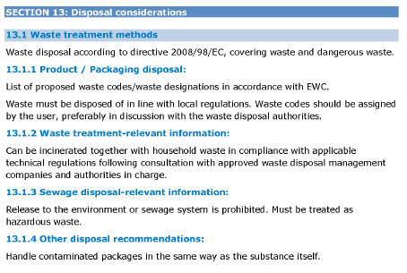
Safety Data Sheets – Sections
Section 13 Disposal considerations
Gives info on
Appropriate treatment methods waste (including packaging)
Should be in accordance with local, national and European legislation
Waste Management of Substances or mixtures
Waste disposal
The legal responsibility for disposal rests with the disposer
Ensure that the information form this section is incorporated into the Waste Management Programs
Notes:
NOTE:
Section 13
gives information on:
The proper waste management of the substance or mixture;
The appropriate treatment methods for both the substance or mixture waste.
Waste disposal
should be in accordance with local, national and European legislation
If the waste is likely to include any contaminated packaging waste, advice on treatment methods for contaminated packaging should also be provided as appropriate.
The legal responsibility for disposal rests with the disposer
Ensure that the information form this section is incorporated into the Waste Management Programs
A CLOSER LOOK FOR RECIPIENTS
Check that the information in this section is consistent with the classification in Section 2 and with the exposure controls in Section 8.
Bear in mind that if the substance becomes a waste, REACH ceases to apply and waste legislation becomes the correct legal framework within which to
operate.
The legal responsibility for disposal rests with the disposer. When confronted with limited information e.g. “Dispose of in accordance with all applicable
local and national regulations”, it may be desirable to obtain advice from reputable waste contractors.

Slide 20
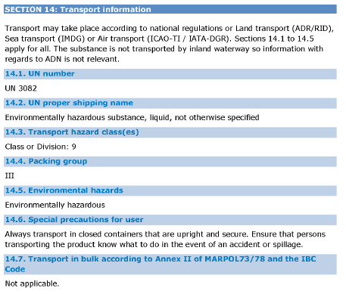
Safety Data Sheets – Sections
Section 14 Transport information
Gives info on
UN Number
Additional information, such as tunnel restriction codes or indication of a marine pollutant
Special precautions for the user
Transport in bulk by sea or inland waterways, when applicable
Transportation classification for the chemical
(e.g. Road , Rail, Sea, Inland waterways and Air)
Check that the transport packages received are
labelled and compliant with the information in this Section
Notes:
NOTE:
Section 14 gives information on:
• Classification for transportation of the substance or mixture by road, rail, sea, inland waterways or air (UN numbers and associated detail);
• Additional information where relevant, such as tunnel restriction codes or indication of a marine pollutant;
• Special precautions for the user (this may refer to Section 8 (Exposure Controls/Personal Protection of the SDS));
• Information on transport in bulk by sea or inland waterways, when applicable.
Check that received packages are labelled and compliant with the information in this Section
This section provides information on the transport classification applicable for each of the UN Model Regulations governing transport in Europe.
A CLOSER LOOK FOR RECIPIENTS
Check that information is consistent with the classification and composition in Sections 2 and 3.

Slide 21
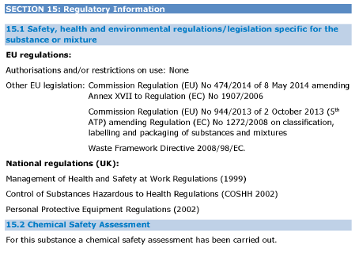
Safety Data Sheets – Sections
Section 15 Regulatory information
Gives info on
If a chemical safety assessment (CSA) has been carried
Substance is subject to any restrictions or to authorisation, it should be indicated in this section
Other applicable legislation specific for the chemical
Check whether your relevant national legislation is indicated & is consistent with the substance/mixture composition and classification
Notes:
NOTE:
Section 15 gives information on:
• The safety, health, and environmental legislation specific for the chemical, which is not already indicated elsewhere in the SDS;
• Whether a chemical safety assessment (CSA) has been carried out.
The relevant legislation may include any national and/or regional regulatory information on the chemical, where it is being placed on the market, as well as
European legislation, such as the young workers or pregnant workers, plant protection and biocides, water framework etc. When a CSA has been carried out, for hazardous substances registered at 10 tonnes or more per year, the registrant must also prepare exposure scenarios as part of their assessment.
If a substance is subject to any restrictions or to authorisation, it should be indicated in this section.
Relevant national legislation
Check whether your relevant national legislation is indicated, and consistent with the substance/mixture composition and classification.
Authorisation and restriction Specific obligations apply to the use of authorised substances. See Q&A 151 for more information.
(https://echa.europa.eu/support/qas-support/qas) If a restriction applies, it has to be complied with.
Chemical safety assessment
A chemical safety assessment (CSA) must be carried out for substances registered at a manufacture or import quantity of 10 tonnes or more per year per
registrant. A registration number in Section 1 (for a substance as such) or Section 3 (for a substance in a mixture) indicates that a substance is registered.
When a CSA has been undertaken for a hazardous substance, relevant exposure scenarios should be attached to the safety data sheet for the substance.
The information should also be included in the information provided for any mixture containing the substance. For a mixture containing such a
substance, the supplier may choose to integrate the information into the main body of the SDS, append safe use information for the mixture (SUMI) or
attach relevant exposure scenarios.
When risk management measures from an exposure scenario are integrated in the SDS or a consolidated annex, you still have to fulfil the obligations
described in the “Exposure Scenario” section to check that your use of the mixture is covered.

Slide 22
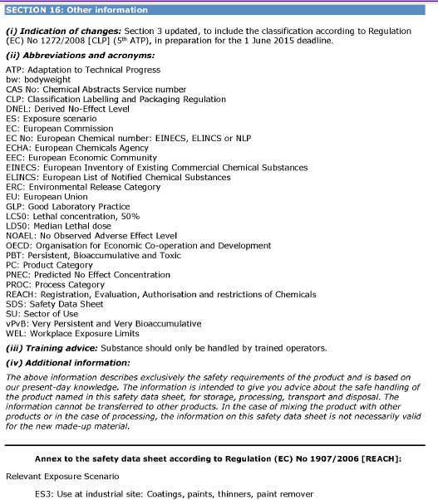
Safety Data Sheets – Sections
Section 16 Other information
Gives info on
Changes from previous SDS versions
Legend to any abbreviations and acronyms used
Key literature references and sources for data
For mixtures, the procedure used to derive the classifications
Advice on training for those handling chemical
An index table or table of contents for an attached exposure scenarios
Many SDS will include a disclaimer or notice to the reader. Keep in mind that such statements ‘’do not absolve’’ the supplier of their legal obligations
Notes:
NOTE:
Relevant information that has not been included in the previous sections is provided in Section 16. This might include:
• Changes from the previous SDS version. If you need an explanation of the changes then contact your supplier;
• A legend to any abbreviations and acronyms used;
• Key literature references and sources for data;
• For mixtures, the procedure used to derive the classification;
• Relevant risk phrases, hazard statements, safety phrases and/or precautionary statements (number and full text);
• Advice on training, for those handling the chemical;
• An index table or table of contents for any attached exposure scenarios.
Many SDS will include a disclaimer or notice to the reader. Such statements do not absolve the legal obligations of the supplier to provide accurate and useful information.
Example 1 (https://echa.europa.eu/documents/10162/22786913/sds_section16_example1_en.pdf)
Example 2 (https://echa.europa.eu/documents/10162/22786913/sds_section16_example2_en.pdf)

